Slide 1

1201 Kun-Woo Kim
1514 Deuk-Hwan Cho

Slide 2
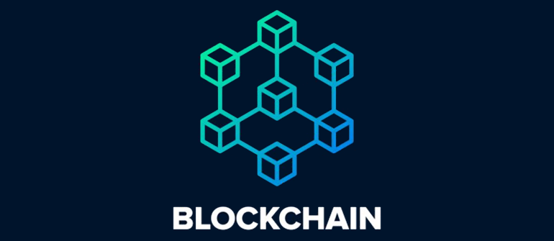
BLOCK CHAIN?
CRYPTOCURRENCY
ATTACK/VULNERABILITY
POSSIBLE MITIGATIONS

Slide 3
BLOCK CHAIN?
When we say the words “block” and “chain” in this context, we are actually talking about digital information (the “block”) stored in a public database (the “chain”).
Public database
Informaion 1
Information 3
Information 4
Information 2

Slide 4
6 KEY FEATURES OF BLOCKCHAIN TECHNOLOGY
Cannot be corrupted
Decentralized technology
Enhanced Security
Distributed ledgers
Consensus
Faster settlement

Slide 5
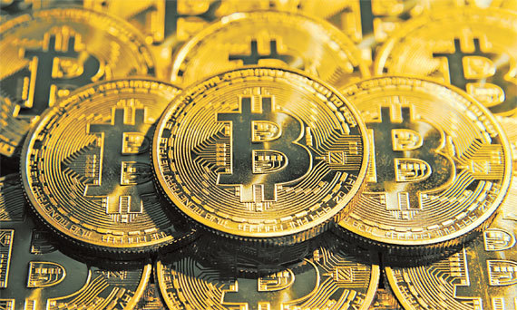
Crypto-Currency
BITCOIN
A cryptocurrency is a digital asset designed to work as a medium of exchange that uses strong cryptography to secure financial transactions, control the creation of additional units, and verify the transfer of assets.

Slide 6

How the block chain work to cryptocurrency
Date
Time
Dollar
Digital signature
Unique codes

Slide 7
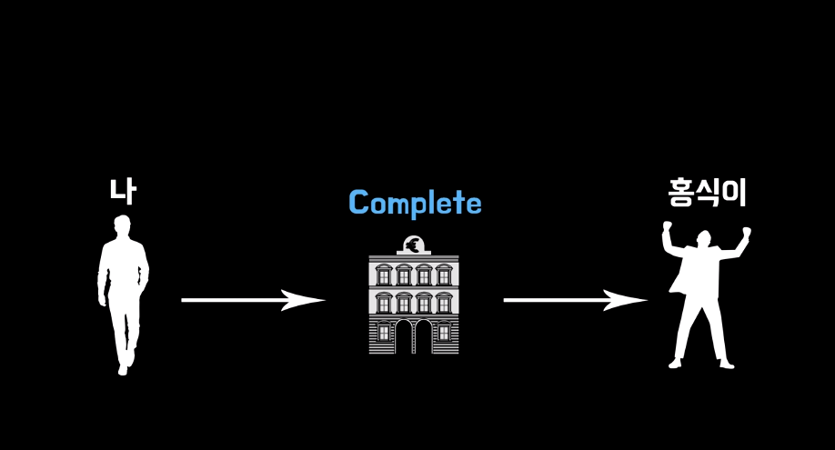
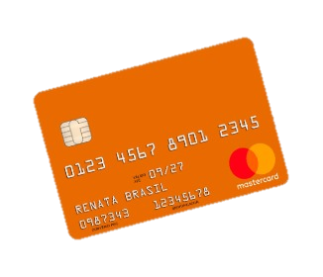

Slide 9


Slide 10

ALMOST IMPOSSIBLE TO HACK DIRECTLY
The only way to collapse this system is ‘51% ATTACK’
-> which is only possible at small size block chain
Usually hacked by indirective way

Slide 11
Every vulnerabilities comes from blockchain’s characteristic

Slide 12
1. NO one can change the decision in block chain
Hacker can’t distract your action
If user forget or make a mistake
It can be a big damage

Slide 13


2. Smart contract HACKING of blockchain
Block chain
TRANSACTION

Slide 14
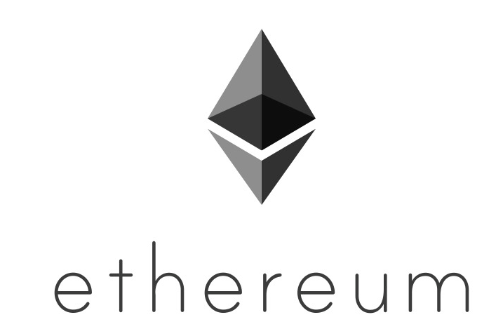
Smart Cast
Ethereum is an open source, public, blockchan-based distributed computing platform and operating system featuring smart contract (scripting) functionality.

Slide 15
DAO event
In 2016 a decentralized autonomous organization called The DAO, a set of smart contracts developed on the platform, raised a record US$150 million in a crowdsale to fund the project. The DAO was exploited in June when US$50 million in ether were taken by an unknown hacker. The event sparked a debate in the crypto-community about whether Ethereum should perform a contentious "hard fork" to reappropriate the affected funds. As a result of the dispute, the network split in two. Ethereum (the subject of this article) continued on the forked blockchain, while Ethereum Classic continued on the original blockchain. The hard fork created a rivalry between the two networks.

Slide 16

You should be careful

Slide 18
Sourse
https://www.investopedia.com/terms/b/blockchain.asp#what-is-blockchain
https://en.wikipedia.org/wiki/Ethereum

